Slide 1
NE 795: Advanced Reactor Materials
Fall 2023
Dr. Benjamin Beeler

Slide 2
Housekeeping
Sent out a google form for the presentation survey

Slide 3
Last Time
Completed FCCI for metallic fuels
highlighted different compositions, and which species participate
Ce and Nd are primary FPs that diffuse into the cladding; Fe and Ni diffuse into the fuel
Metal Fuel Fabrication
injection casting process
Pyroprocessing
well established method relying on molten salt and anode deposition
Metallic fuel performance modeling
BISON, ALFUS, LIFEMETAL
all still currently require extensive assumptions

Slide 4
Mixed oxide fuel

Slide 5
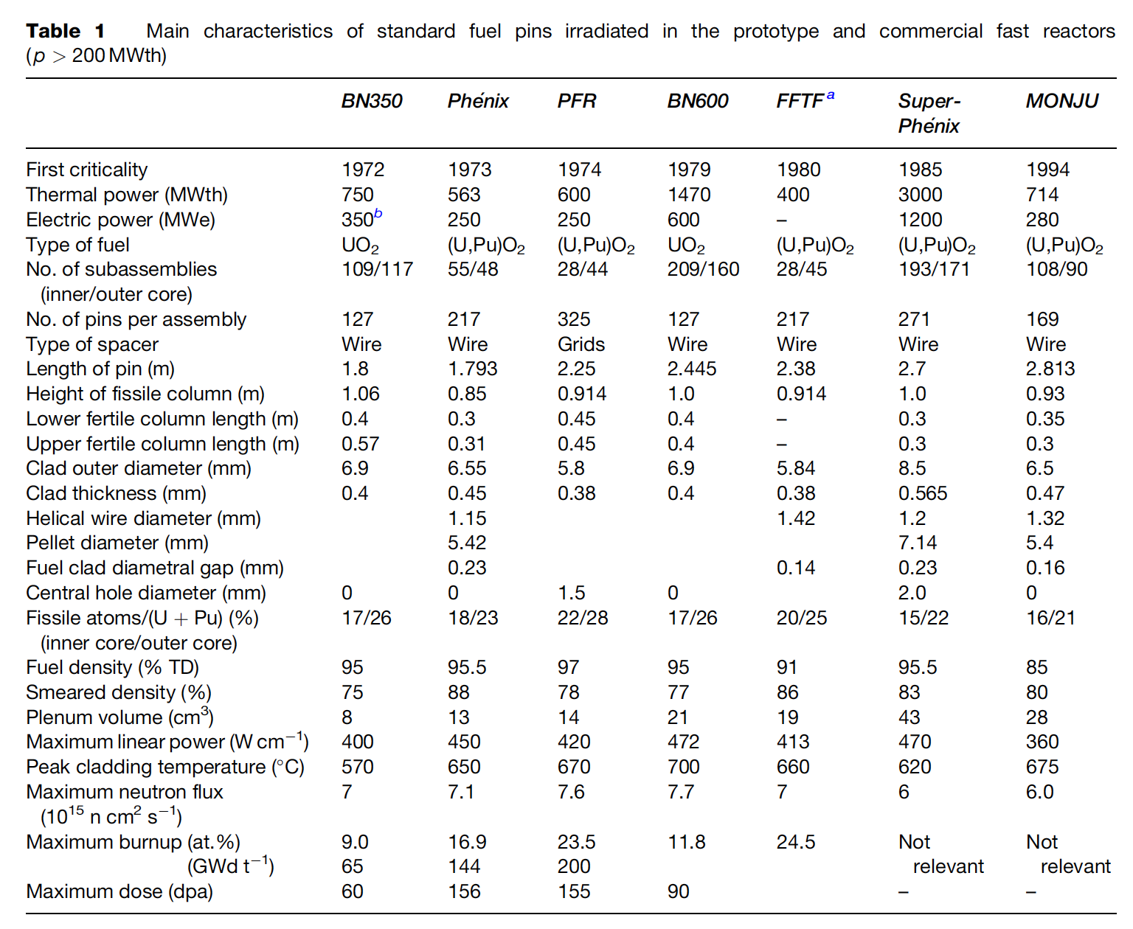
MOX Introduction
Despite some disadvantages, such as its low U density, poor thermal conductivity, and its chemical reaction with sodium, MOX fuel (U,Pu)O2 is the fuel that has been used most in fast reactors
In order to avoid the dramatic swelling of metallic fuels, MOX fuels were explored in fast reactors
Behavior was observed to be satisfactory and was relatively widely implemented in SFRs

Slide 6
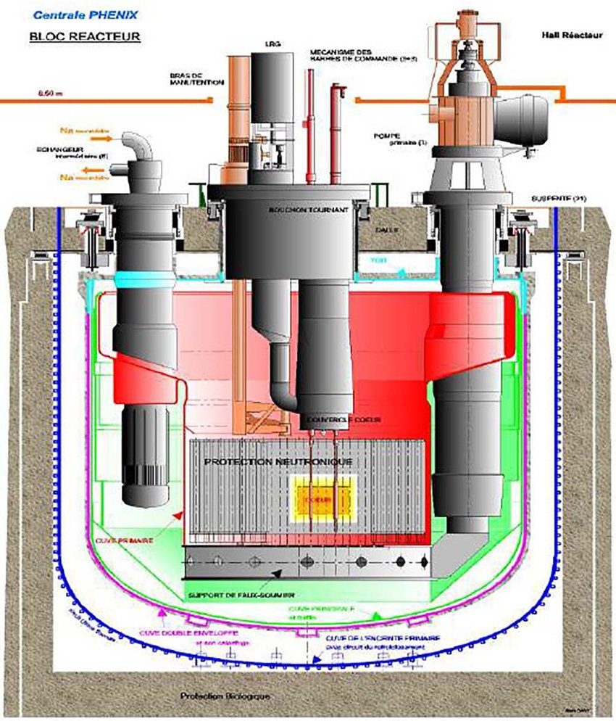
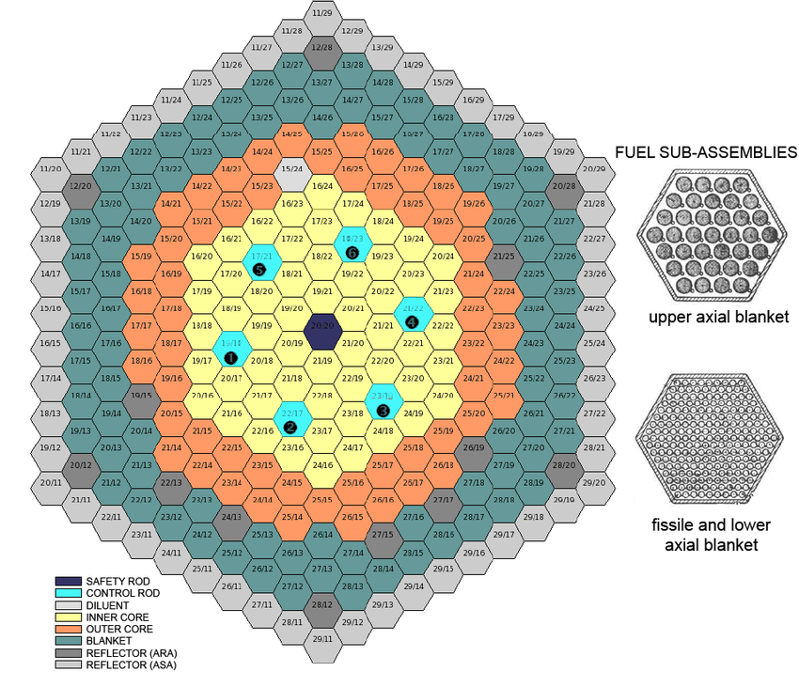
MOX Fuel Design
Typical fuel pin is 2-3 m long, with MOX pellets stacked 1 m with a plenum above and below the fueled zone
He bond, steel cladding
Hexagonal core and hexagonal assemblies
Each assembly contains 100-200 fuel pins
Schematics are from Phenix reactor

Slide 7
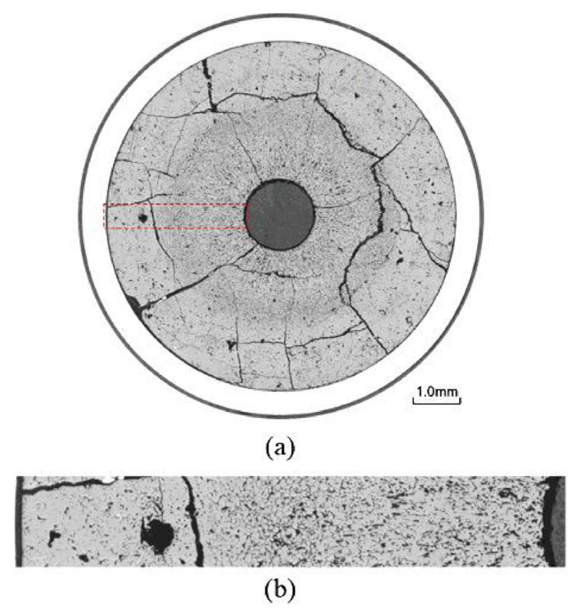
MOX Fuels in SFRs
MOX fuel operates at linear heating rates that are 2X higher than LWR fuels (450 W/cm)
MOX will run at higher temperatures than LWR fuel, and thus with different properties
Fission product phases and evolving microstructures create highly localized properties that can differ significantly from the bulk fuel
Stoichiometry and Pu content are important factors that dictate thermal properties

Slide 8
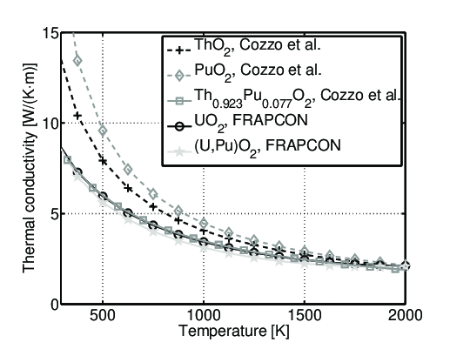
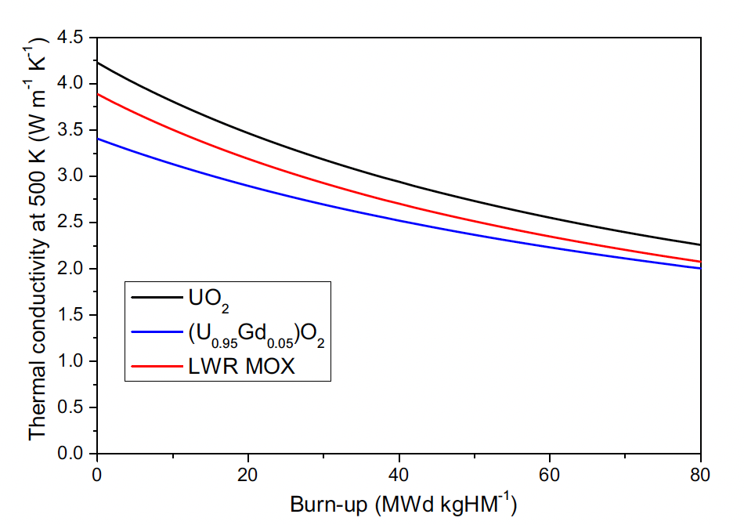
Thermal Properties
Because we have higher temperatures, knowledge of the thermal field is critical
Thermal conductivity is similar to UO2, transport via phonons
Porosity, off-stoichiometry, fission products, etc., cause scattering and degrade k, metallic precipitates increase k
The mixed oxide typically has worse conductivity than either pure oxide
Degrades with burnup
Various models have been developed to describe the degradation

Slide 9
MOX Restructuring
Oxide nuclear fuels are commonly touted for their outstanding high temperature capabilities under irradiation, but this stability comes with the tradeoff of low thermal conductivity
Due to the low thermal transport, a steep temperature gradient is formed along the radius of the fuel pellet, with the hottest region at the center of the pellet and coolest near the cladding
This leads to grain growth and restructuring
Pu bearing fast reactor oxide fuels display four defining regions of a restructured pellet:
the central void, the columnar grain growth region, the equiaxed grain growth region, and the as-sintered region
The higher temperatures and heating rates form coarse, elongated grains that grow radially toward the outer rim of the fuel

Slide 10
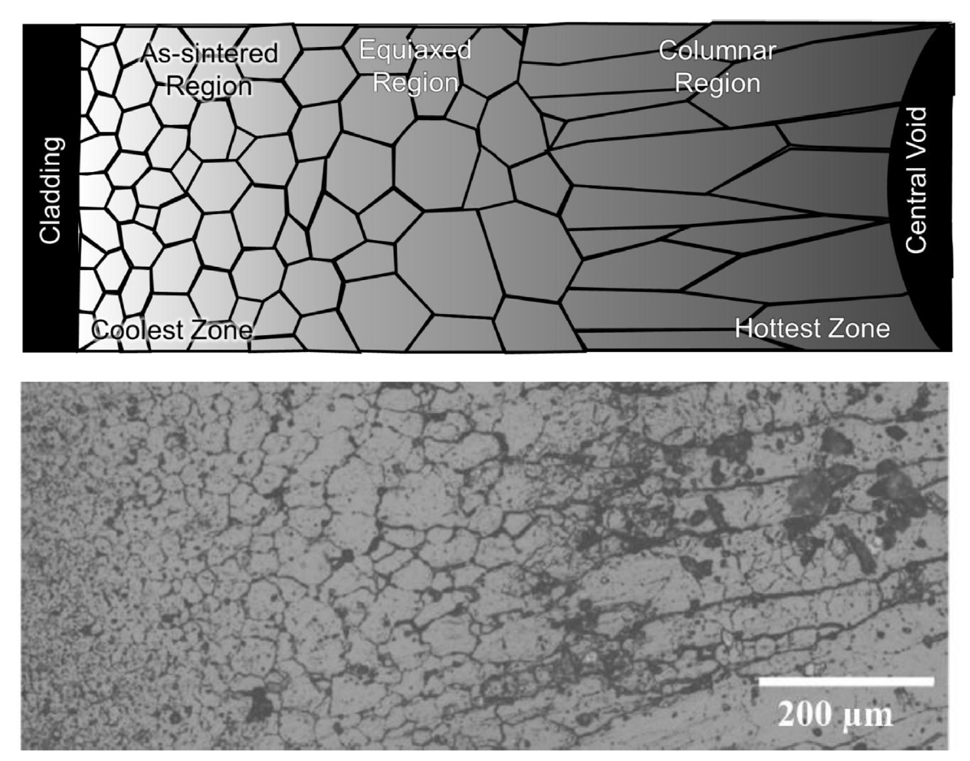
MOX Restructuring
The equiaxed region consists of grains that have undergone significant growth when compared to the un-irradiated samples
Central voids have been shown to appear in irradiation times as short as 10 min, demonstrating that the appearance the central void is a result of fuel temperature and linear heating rate, not high burnup
The central void forms from the accumulation of voids and pores present in the fuel along a thermal gradient

Slide 11
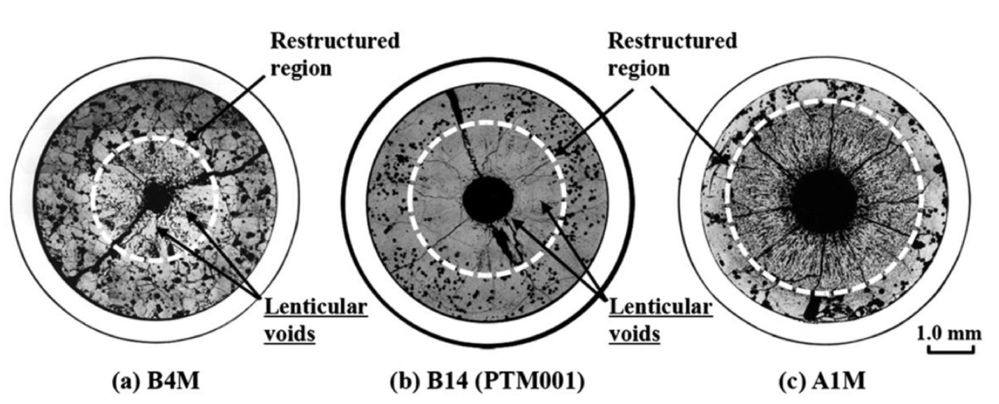
MOX Pore Formation
Heating Rate

Slide 12
MOX Pore Formation
The smallest spherical pores are highly mobile, being able to quickly and easily move through the restructured region
Intermediate sized pores become flat and elongated as they travel towards the fuel centers, leaving streaks at the tips of the voids as they travel
These “lenticular” voids are the most readily identifiable porosity feature in the irradiated MOX fuels due to their distinct shape

Slide 13
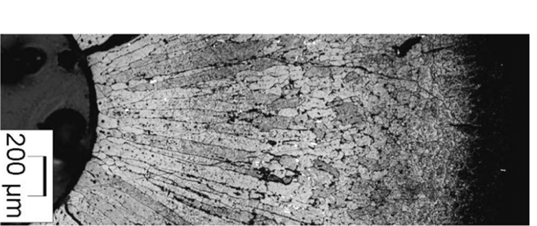
Pore Migration
Hot to cold side of the pores has a steeper temperature gradient than in the fuel
The pressure of the fuel vapor is higher on the hot side of the lenticular pore, which induces an evaporation–condensation mechanism
Matter evaporates from the hot face and condenses on the cold face
Induces an inverse displacement of the lenticular pores that climb the thermal gradient toward the center of the pellet
The oxide vapor condenses on the cold side in a nearly single crystal way
The lenticular pores destroy the initial fuel microstructure and leave behind very elongated ‘columnar grains’ that appear clearly in micrographs

Slide 14
MOX Restructuring
The velocity of the pores varies rapidly with temperature, and the columnar grains only form at temperatures above ~1800C
Below 1800C, an equiaxed region consists of grains that have undergone significant growth when compared to the un-irradiated samples
At the periphery of the fuel pellet, temperatures are sufficiently low to limit grain growth, and thus the microstructure doesn’t undergo rapid changes

Slide 15
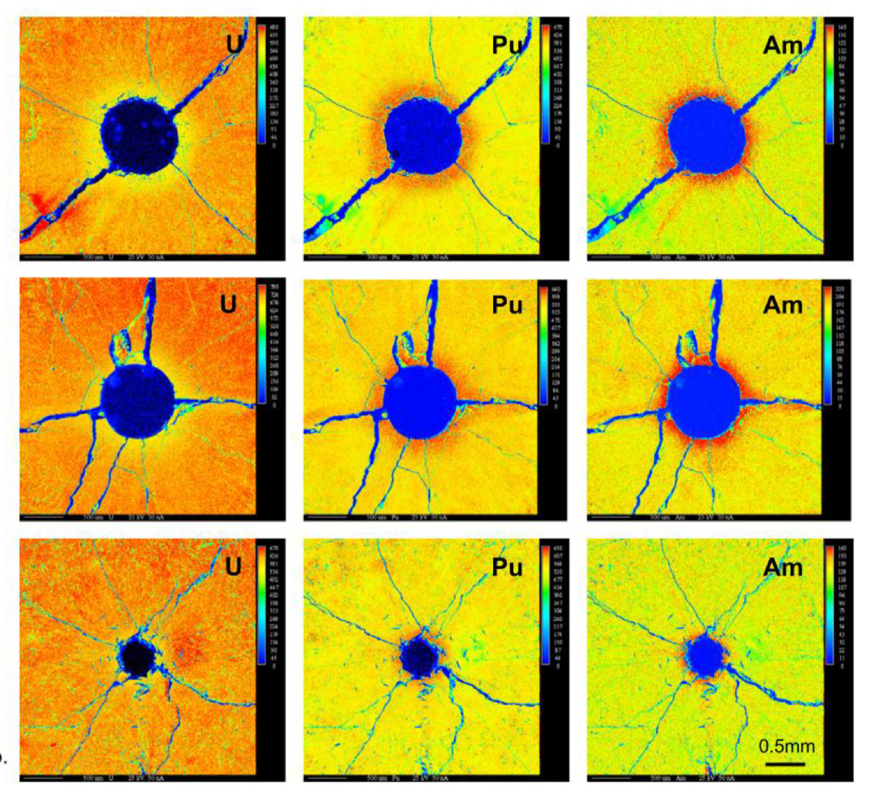
Redistribution of Pu
The movement of pores leads to a redistribution of plutonium, resulting in a spike in Pu concentration surrounding the central void
Similar behavior has been observed for americium
This transuranic concentration increase is accompanied with a decrease in U concentration
This redistribution increases the local fission rate and centerline temperature, while generating lower melting point phases

Slide 16
Redistribution of Pu
This phenomenon is currently understood as an evaporation-condensation process
The fuel at the edge of the pore closest to the centerline becomes gaseous inside the pore and deposits itself on the cooler region of the pore closest to the cladding
UO2 is the more volatile of the U/Pu heavy metal species present in the fuel matrix
The high oxygen potential can lead to a high partial pressure of UO3 within the self-contained pores
Enriched regions of PuO2 are left behind and deposited at the leading edge of the central void as the porosity agglomerates in the fuel center
Some experiments on O/M ratio seems to point towards higher O potential leading to more redistribution
While this is the working theory, it is not clear if this explanation can also account for the necessary pore velocities
No experimentally proven substitution has been put forth as a replacement theory to the observed features

Slide 17
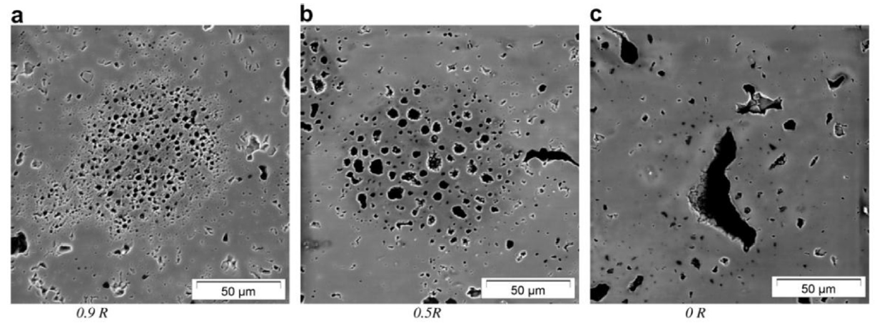
Pu-rich Agglomerates
Regions of high Pu concentration form in the MOX fuel matrix due to incomplete mixing during fabrication
Clusters of dispersed porosity form in high Pu concentration regions because of the high fission rate
Thermal conductivity of the spots is also lower than the surrounding matrix, thus the PAs are both hotter and undergo a greater number of fission events in a very small region
Burnup in these regions may be greater than 2-3 times that of the pellet as a whole
The morphology of porosity in the agglomerates depends on the temperature, with smaller bubbles in cold regions and large bubbles in hot regions
Porosity formed due to PAs are visually distinct from fission gas bubbles or pre-existing porosity

Slide 18
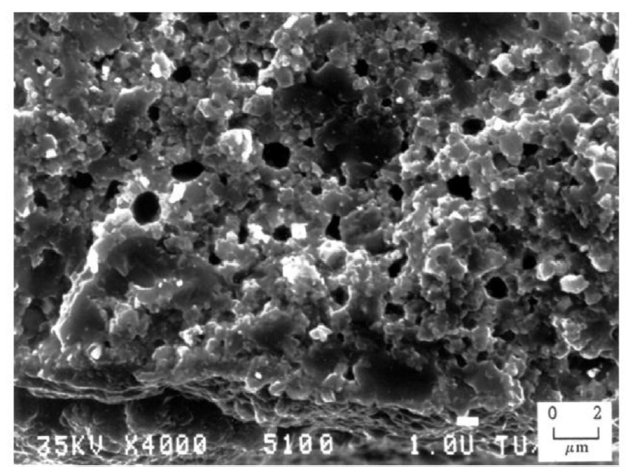
Pu-rich Agglomerates
The presence of the high burnup structure (HBS) has been observed within the PA regions
The HBS is basically a fine grained, cauliflower-like structure
In MOX fuels, the HBS structure appears in fuels following burnups between 60 and 80 GWd/tM at temperatures below approximately 1100C
PA's reach these local burnups at pellet burnups far below this threshold

Slide 19
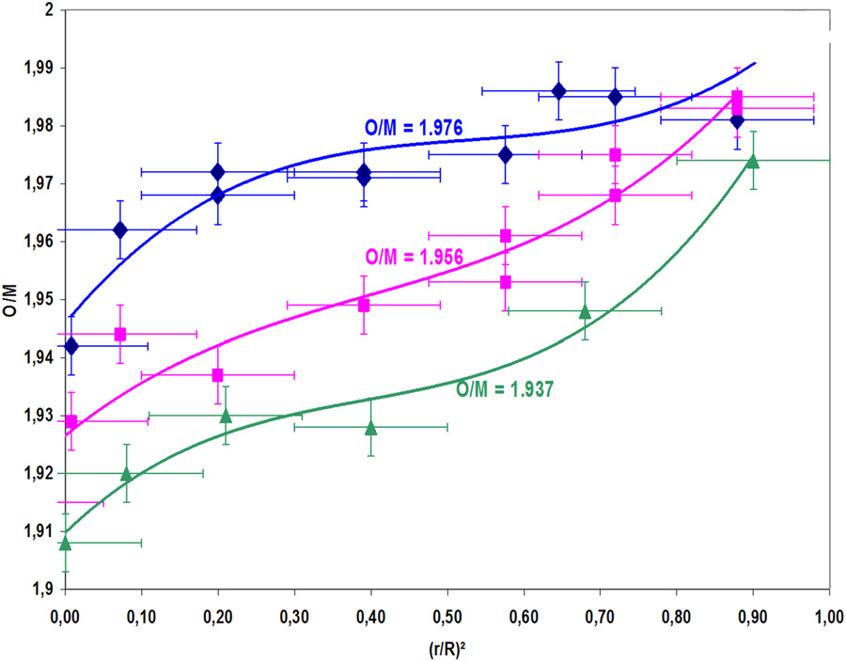
Oxygen Redistribution
The as-fabricated oxide pellets used as fuel in fast reactors are always hypostoichiometric with an initial O/M typically in the range 1.93–2.00
Oxygen is redistributed radially, migrating down the thermal gradient, thus bringing the composition close to stoichiometry near the periphery, whereas the O/M ratio becomes very low in the hottest area
Oxygen transport is likely a combination of vapor and solid diffusion

Slide 20
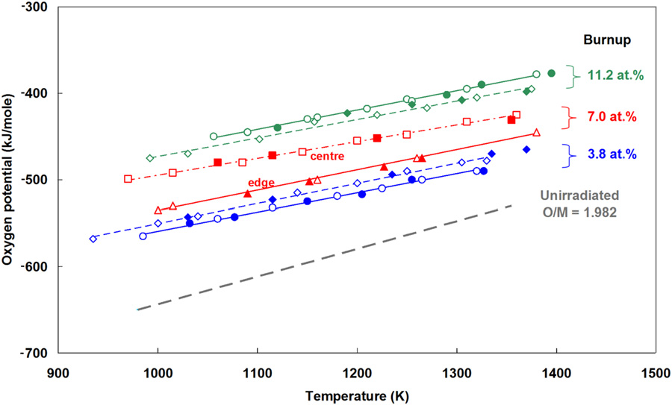
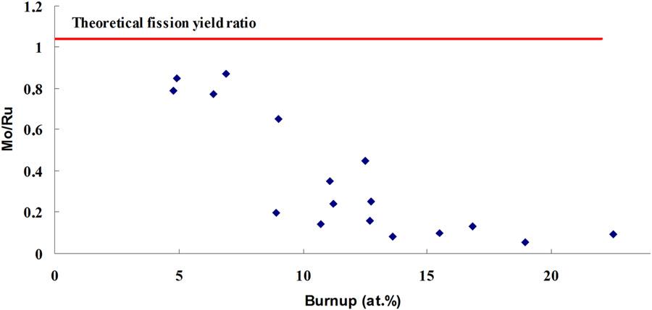
O/M Ratio
Fission releases two oxygen atoms, which cannot be fully bound by the fission products, this increases the O potential in the fuel as dissolved O
The O potential increases until the point where Mo starts to oxidize, leaving the metallic inclusions
The O/M ratio increases until Mo starts to oxidize, then maintains at approximately 2.0 or thereabouts

Slide 21
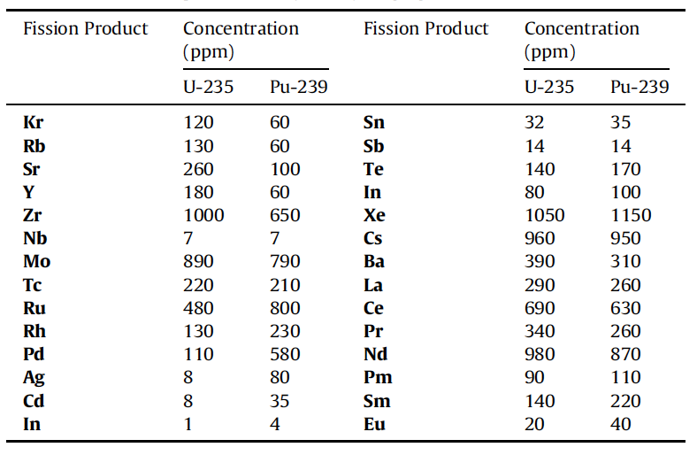
Solid Fission Products
Fission products in oxide fuels can be grouped into 4/5 categories
Fission gases and volatile species
Metallic precipitates
Oxide precipitates
Soluble oxides
LWR fuel vs Pu-containing MOX fuel, we see a higher concentration Ru, Rh, Pd, and a lower concentration of Zr and Mo
Target higher burnups, so we have a very high inventory of fission products

Slide 22
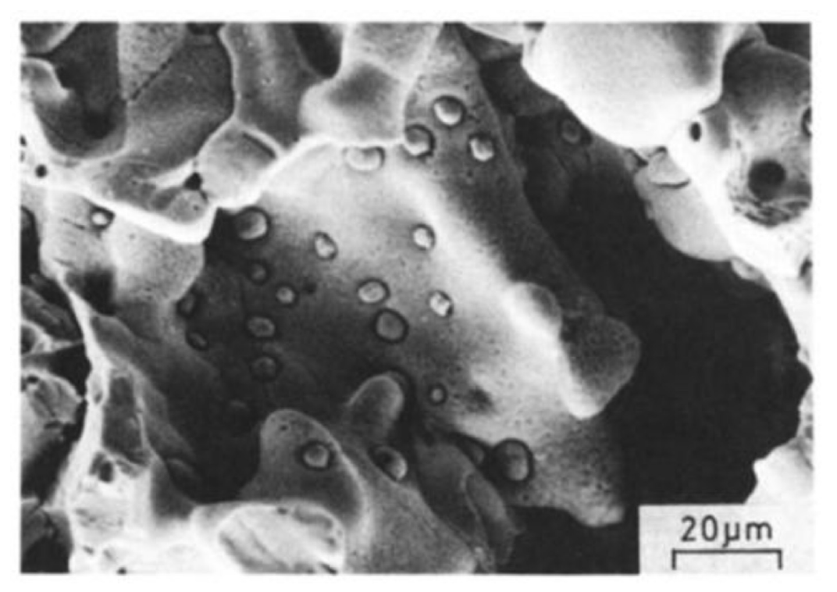
Metallic Inclusions
Mo, Tc, Ru, Rh, and Pd form prominent phases in irradiated nuclear fuels commonly referred to as “white inclusions,” “noble metal,” or “five-metal” precipitates
The particles exist as a solid solution taking on the hexagonal close packed (hcp) structure
The particle size, frequency, and composition exist over a wide range, depending on the burnup and position found within the pellet

Slide 23
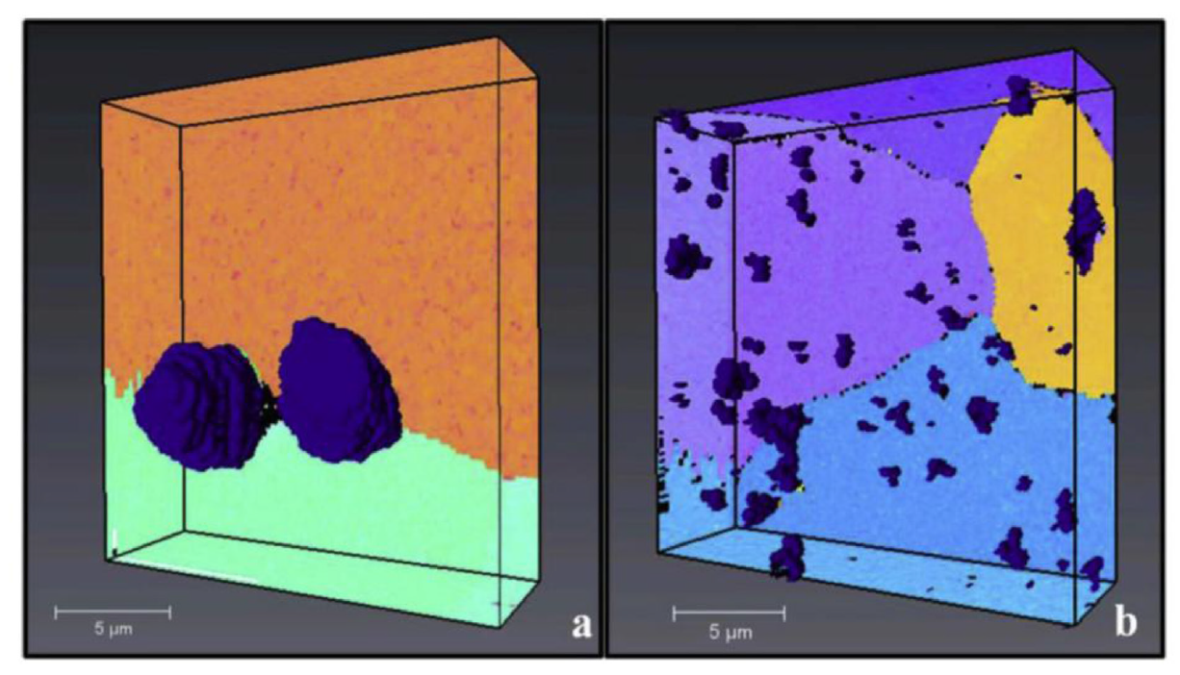
Metallic Inclusions
In the columnar grain region of the fuel, the particles are commonly 5-10 μm in diameter , collecting primarily on the grain boundaries
Particles tend to be much smaller (2 μm and below) in the equiaxed and as-sintered regions, but occur more frequently intragranularly
The particles form as a result of fission product phase agglomeration, as opposed to nucleation and growth process
Columnar Grain Region
Equiaxed Grain Region

Slide 24
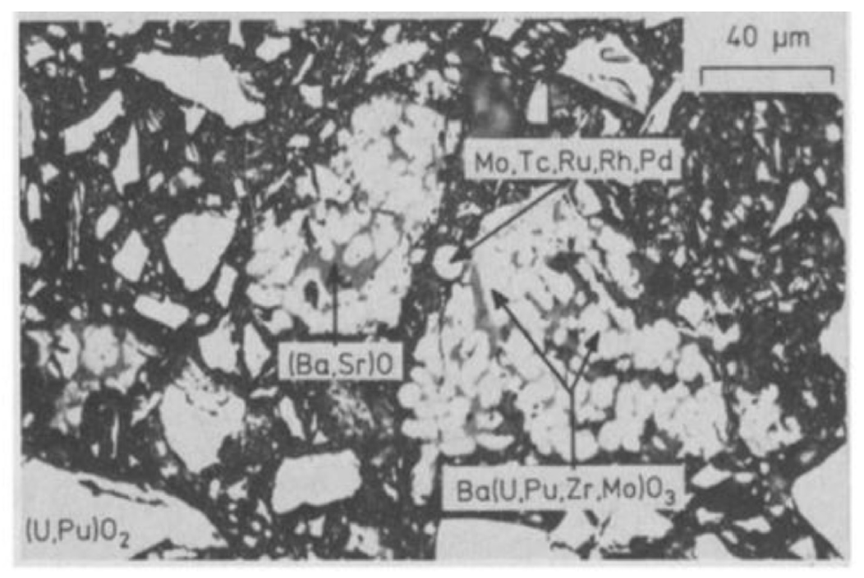
Oxide Phases
Oxides containing Sr, Zr, or the rare earth (RE) elements form solid solutions with either UO2, PuO2, or both at low concentrations
Barium is only soluble to 1.6 at% in MOX fuels and thus precipitates a separate oxide phase at higher concentrations
These oxides, commonly referred to as the “grey phase,” form ABO3 perovskite structures, in which A=(Ba1-x-y, Srx, Csy, x,y ≪1) and B=(U, Pu, Zr, Mo, RE)
The particles are primarily Ba rich, followed by Zr, U, Pu, Mo, Sr, and trace amounts of the remaining products
Due to the sheer number of constituents, the structures are largely unknown
Grey phase is typically found in the equiaxed or outermost regions of the columnar grains commonly intermixed with other constituent oxides

Slide 25
Joint Oxyde Gaine
The volatiles class of fission products produced during reactor operation are of particular interest to fuel-cladding interactions
Cs, Te, and I all evaporate at low operating temperatures and migrate to the coolest part of the fuel assembly where they react with fuel or cladding constituents
Mo has a tendency to combine with Cs and O to become volatile and migrate toward cooler fuel regions
This has been termed Joint Oxyde Gaine (JOG)
JOG is an oxide buildup formed on the fuel surface between the pellet and cladding
After gap closure, there remains a minimal residual gap
Primarily Cs2MoO4 or Cs2(U, Pu)O4, the JOG structure is irregular and dense, found in regions where the peak fuel temperature is lowest

Slide 26
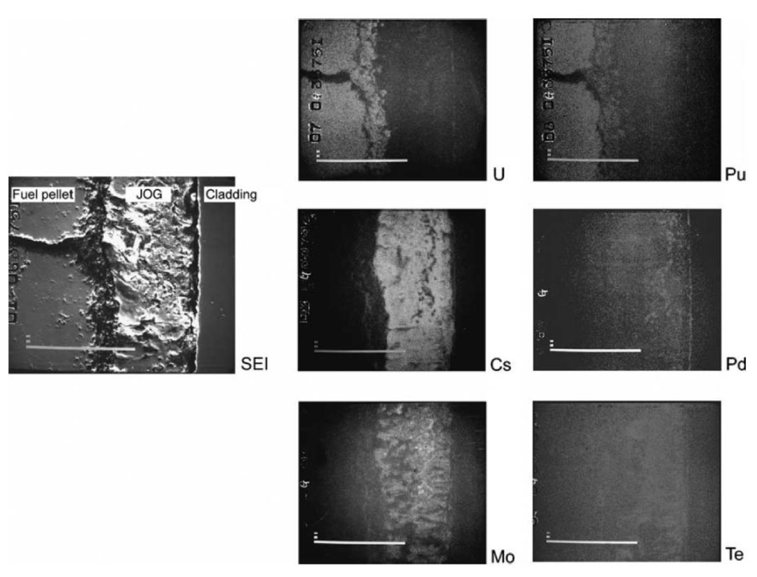
Joint Oxide Gain
The volatile constituents of the JOG structure evaporate from the fuel pellet at high temperatures and condense to become solid at the cooler top or bottom of the fuel assemblies
It is believed that the existence of JOG aids in thermal transport of the fuel, as the oxide structures have higher thermal conductivity than a fuel-cladding gap filled with fission gases

Slide 27
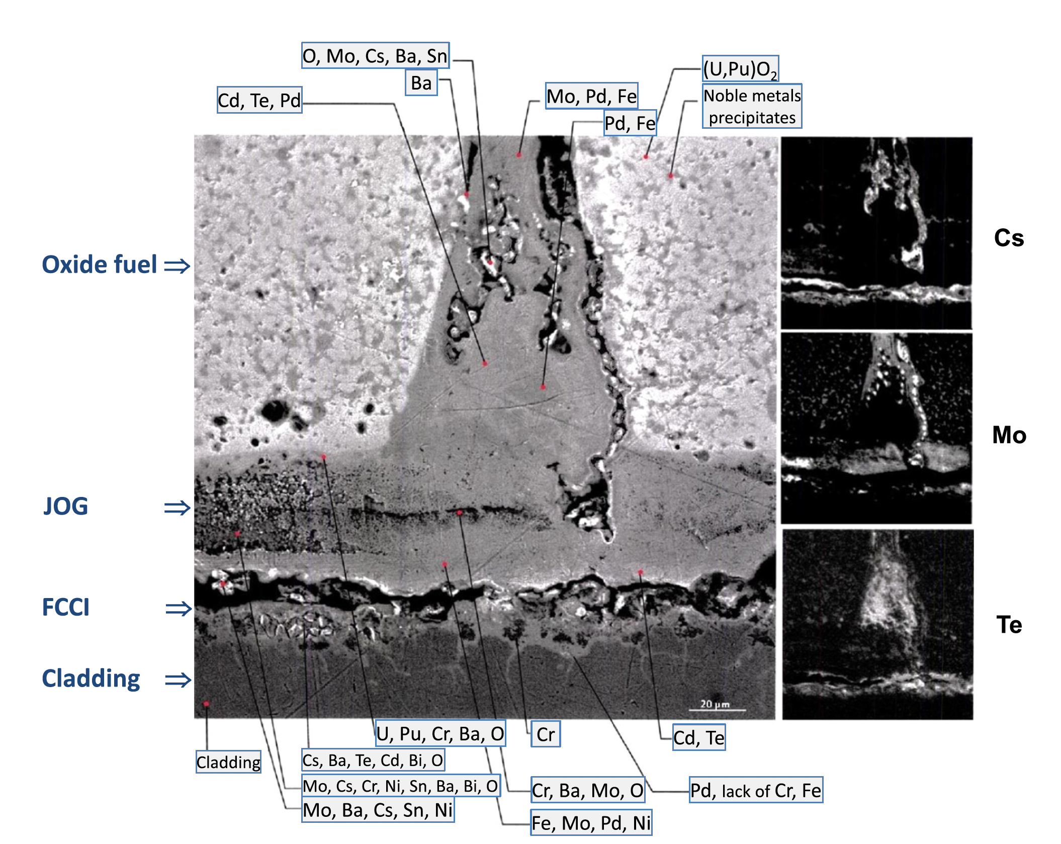
Joint Oxide Gain
JOG acts as a mechanical buffer, limiting the amount of PCMI, or stresses in the cladding
JOG reduces fuel swelling, by allowing fission products to leave the fuel into a preferable chemical state
Fission products in the JOG play a predominant role on FCCI and on the resulting strong corrosion

Slide 28
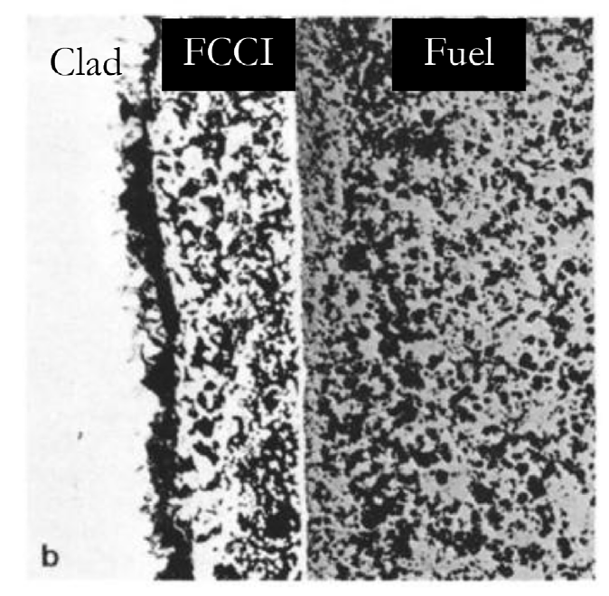
MOX FCCI
The cladding inner surface temperature of LWR MOX fuels do not reach sufficiently high temperatures under normal operating conditions to initiate detrimental oxidation and chemical attack
FCCI manifests itself in three primary modes: matrix attack, intergranular attack, or combined, which demonstrates the properties of both matrix and intergranular attack
Matrix FCCI attack corresponds to the localized oxidation of the cladding material, with primarily oxidation of the Cr in the stainless steel

Slide 29
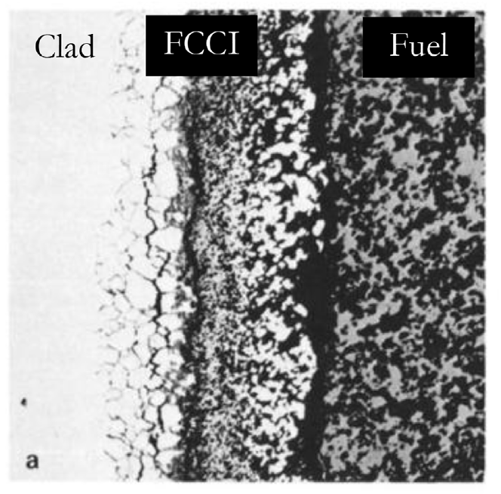
MOX FCCI
Intergranular attack modes occur due to the depletion of Cr in grain boundaries due to the formation of Cr23C6 carbides allowing penetration of corrosive species
Oxygen and volatile fission products (Cs, Te, I, etc.) are the primary culprits of FCCI initiation in oxide fuel systems
In MOX fuels, the oxygen potential of the system is the greatest difference from LWR UO2
The preferential formation of noble metals rather than oxide formers leads to an excess of available oxygen in the system

Slide 30
MOX FCCI
Under normal operation, stainless steel cladding forms a chrome oxide (Cr2O3) layer that acts to protect the cladding from corrosion
Cs is generally unreactive with stainless steel claddings, but reacts with the protective oxide layer to create Cs-chromates (Cs2CrO4 or Cs2Cr2O7) when excess oxygen is present
The decay of the protective oxide layer causes deeper penetration of the FCCI into the cladding
Iodine is primarily bound to Cs in the form of CsI, and can lead to an enhancement in oxidation in hyperstoichiometric fuels
Tellurium is highly active when combined with Cs to create Cs2Te, which can dissolve cladding constituents in the presence of high oxygen potential
The O/M ratio of the fuel before and during irradiation are significant factors, and FCCI can potentially be limited by operating with a hypostoichiometric initial fuel composition

Slide 31
MOX Summary
Phenomena of interest: Restructuring, O and Pu redistribution, Pu agglomerates, fission product chemistries, JOG formation, and FCCI
O/M ratio is one of the most significant factors in determining the nature of actinide redistribution, fission product precipitate chemistries, and FCCI formation
The effects of fission product precipitates and Pu agglomerates on fuel thermal behavior is highly localized with little discernible influence on the overall fuel burnup behavior

Slide 32
Questions?

